Slide 1


Technology Networks for Conservation Agriculture: Bungoma, Kenya
Jennifer Lamb
SANREM CRSP
Technology Networks Workshop
Bungoma, Kenya
February 14, 2012
Notes:
Thank you for being here, I am excited to share with you the results of our study on networks for CA

Slide 2
What is the project?
Lead institution: University of Wyoming
Development and Transfer of Conservation Agriculture Production Systems (CAPS) for Small-holder Farms in Eastern Uganda and Western Kenya

Slide 3
Who are the implementing partners?
Universities:
  University Of Wyoming
  Makerere University
  Moi University
Ngo’s:
  AT Uganda
  Manor House
  Sacred Africa
Local Farmer Groups/Key Stakeholders

Slide 4
Core Principles of Conservation Agriculture
Three principles:
  Crop rotation
    Mixing and rotating crops which maintain/improve soil fertility
  Maintaining a permanent crop cover
    The soil should be covered as much as possible
  Minimizing tillage
    Disturb the soil as little as possible

Slide 5
Minimizing Tillage
Conventional farming:
  farmers plough/hoe to improve the soil structure and control weeds.
  Over the long term, this:
    destroys the soil structure
    contributes to declining soil fertility
Conservation agriculture:
  Tillage is reduced to ripping planting lines or making holes for planting
  Ideal: plant direct into the soil
  Accomplished without plowing/disturbing the rest of the field

Slide 6
Maintaining crop cover
Conventional farming:
  Remove or burn the crop residues or mix them into the soil with a plough or hoe
  Soil is left bare, so it is easily washed away by rain, or is blown away by the wind.
Conservation agriculture:
  Crop residues left on the field
  Mulch and special cover crops protect the soil from erosion
    Helps limit weed growth throughout the year.

Slide 7
Mix and rotate crops
Conventional farming:
  Same crop is sometimes planted each season
  Allows certain pests, diseases and weeds to survive and multiply, resulting in lower yields.
Conservation agriculture:
  This is minimized by:
    Planting the right mix of crops in the same field
    Rotating crops from season to season that require different nutrients from the soil.
      Helps to maintain soil fertility.

Slide 8
SANREM Principles and procedures
Working with partners in the targeted research communities
Understanding values of activities to community members
How community members benefit
Created local advisory councils—why you are here today

Slide 9
Principles and procedures
Research Project Objective:
  Develop new knowledge to be applied by community members
Project does not have the resources to provide inputs, means for achieving development on a large scale
Learning partnerships:
  Researchers committed to learning from community members
    Production systems and way of life
  Communities should benefit by
    Learning about their resources, potentials
    How to build more sustainable and profitable systems

Slide 10
Principles and procedures
Conducts research with individuals and communities is on a voluntary basis.
Successful learning occurs when individuals choose of their own accord to think and act in new ways.
Our job is to present and test new ideas and technologies with those communities and community members who are interested in actively learning about new ways to manage their resources.

Slide 11
What is conservation tillage?
Conservation tillage is any method of soil cultivation that leaves the previous year's crop residue (such as corn stalks or wheat stubble) on fields before and after planting the next crop, to reduce soil erosion and runoff.
To provide these conservation benefits, at least 30% of the soil surface must be covered with residue after planting the next crop. Some conservation tillage methods forego traditional tillage entirely and leave 70% residue or more.

Slide 12
Why practice conservation tillage on your land?
Environmental benefits
  Reduces soil erosion by as much as 60%-90% depending on the conservation tillage method; pieces of crop residue shield soil particles from rain and wind until new plants produce a protective canopy over the soil
  Improves soil and water quality by adding organic matter as crop residue decomposes; this creates an open soil structure that lets water in more easily, reducing runoff
  Reduces potential air pollution from dust and diesel emissions
  Crop residue provides food and cover for wildlife
  Conserves water by reducing evaporation at the soil surface
  Conserves energy due to fewer tractor trips across the field

Slide 13
Practical benefits
  Fewer trips across the fields
    saves time and money (lowers fuel, labor and machinery maintenance costs)
    reduces soil compaction that can interfere with plant growth
  Optimizes soil moisture, enhancing crop growth in dry periods or on droughty soils

Slide 14
Where we are in the process
This is a 4 year project. We have 3 years left.
Baseline data collection conducted year 1
  Understand the local production system before the project
Includes trying to understand what people’s thinking about CA was before we started.
  Today’s presentation is to show you some of the results of that baseline study.
We have also completed the first year of experimental trials to begin testing CA principles
  Results are being analyzed.
  Will also be shared with you soon.

Slide 15
Types of CA Tillage Methods
Conservation tillage is especially suitable for erosion-prone cropland. In some agricultural regions it has become more common than traditional moldboard plowing.
Conservation tillage methods include no-till, strip-till, ridge-till and mulch-till. Each method requires different types of specialized or modified equipment and adaptations in management.
No-till and strip-till involve planting crops directly into residue that either hasn't been tilled at all (no-till) or has been tilled only in narrow strips with the rest of the field left untilled (strip-till).

Slide 16
Additional Types of CA
Ridge-till involves planting row crops on permanent ridges about 4-6 inches high. The previous crop's residue is cleared off ridge-tops into adjacent furrows to make way for the new crop being planted on ridges. Maintaining the ridges is essential and requires modified or specialized equipment.
Mulch-till is any other reduced tillage system that leaves at least one third of the soil surface covered with crop residue.

Slide 17
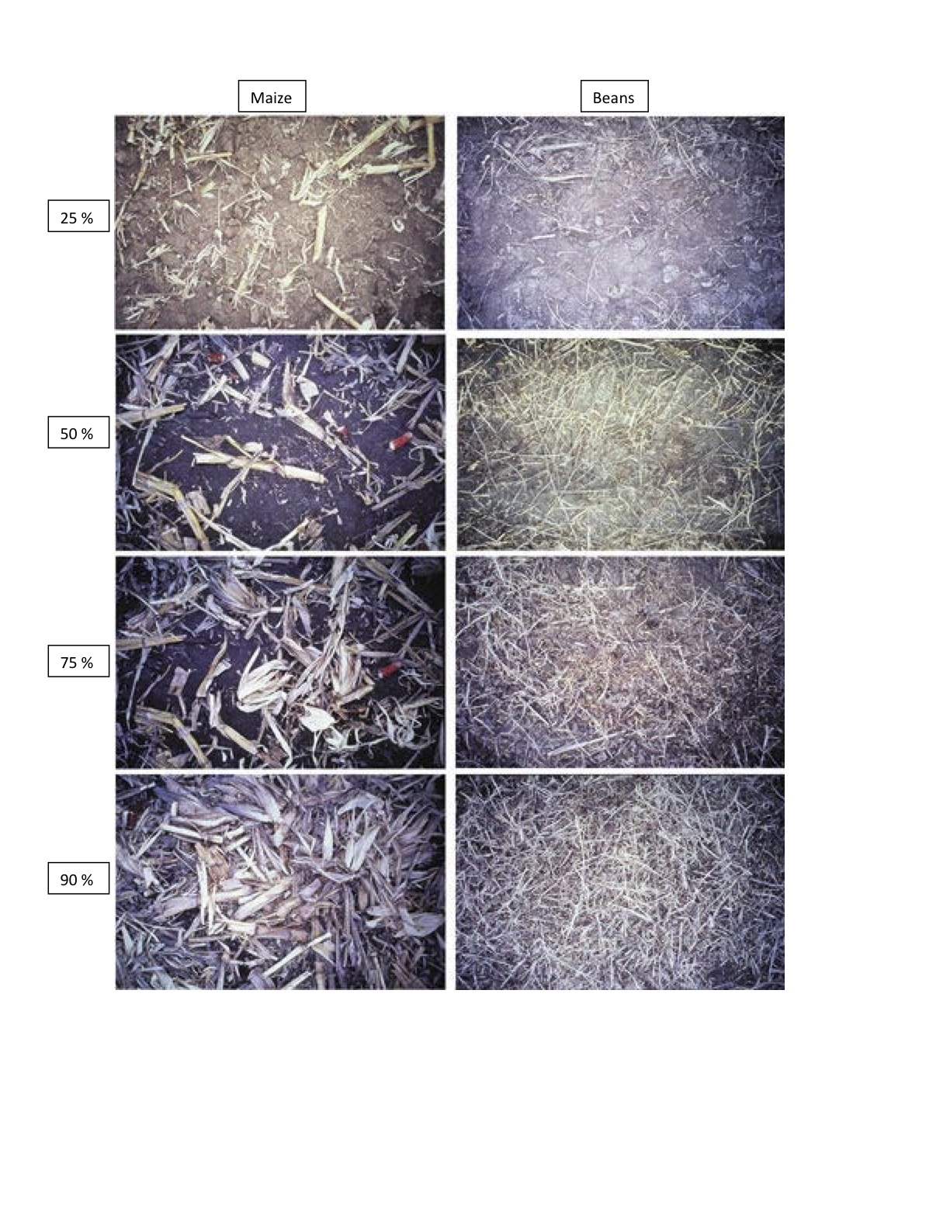

Slide 18
Researching Technology Networks for CA
Successful Conservation Agriculture
  Broad based support network
  Change in mindset regarding agricultural production practices
Everyone has to be involved
  Why we have tried to bring you all here today
Notes:
Change in mindset? –CA means a considerable shift from the way things are currently done

Slide 19
Research Process
Focus Groups in 2010
  Identify key contacts for agricultural production
  List of 19 key actors
Survey conducted in 2010
  75 farm households were asked about their key contacts for agricultural information/resources in Bungoma
  Participants from Ndengelwa used to generate network contacts due to wide distribution of sample
Follow up interviews conducted with 19 individuals in spring 2011
  Community agents
  Agricultural service providers

Slide 20
Research Aims
Understand existing mindsets with regard to agricultural production
  Especially with regard to conservation agriculture
Map the structure of agricultural production networks in Bungoma
Prioritized Identifying:
  Key nodes in the network
    For farmers
    In the whole agricultural production network
  Knowledge and beliefs about CA
    Differences between farmers and service providers/community agents

Slide 21
Farmer Involvement in Agricultural Networks
Variable | Observations | Mean | Standard Deviation | Min Value | Max Value
Resource Contacts | 75 | 7.39 | 4.16 | 0 | 17
Information Contacts | 75 | 7.33 | 4.00 | 0 | 15

Slide 22
Key Resource Contacts for Farmers
Agent Type: | Number of Reports (Out of 75): | Percentage of Farmers Reporting Contact:
Vendor in a agro-vet shop | 53 | 71%
Agricultural researcher | 52 | 69%
Veterinary Service provider | 47 | 63%
Family Member | 46 | 61%
Government Extension agent | 36 | 48%
Leader of farmer organizations | 36 | 48%
Vendor in weekly market | 35 | 47%
Vendor in a shop in urban center | 32 | 43%
Neighbor/friend | 30 | 40%
NGO/ Development Agent | 30 | 40%
Agricultural/Micro Finance Representative | 28 | 37%
Tractor owner/ animal traction provider | 28 | 37%
Leader of women’s organization | 26 | 35%
Government Parastatals | 23 | 31%
Leader of youth organisation | 17 | 23%
Village/Subcounty chief | 14 | 19%
Teacher in village | 11 | 15%
Minister/Priest/Imam in village | 10 | 13%
Local Political leaders | 0 | 0%

Slide 23
Key Information Contacts for Farmers
Agent Type: | Number of Reports (Out of 75): | Percentage of Farmers Reporting Contact:
Agricultural researcher | 53 | 71%
Vendor in a agro-vet shop | 52 | 69%
Family Member | 48 | 64%
Veterinary Service provider | 45 | 60%
Leader of farmer organizations | 39 | 52%
Government Extension agent | 35 | 47%
Neighbor/friend | 31 | 41%
NGO/ Development Agent | 30 | 40%
Vendor in weekly market | 27 | 36%
Agricultural/Micro Finance Representative | 27 | 36%
Leader of women’s organization | 27 | 36%
Vendor in a shop in urban center | 25 | 33%
Government Parastatals | 22 | 29%
Tractor owner/ animal traction provider | 22 | 29%
Village/Subcounty chief | 18 | 24%
Leader of youth organisation | 18 | 24%
Minister/Priest/Imam in village | 12 | 16%
Teacher in village | 10 | 13%
Local Political leaders | 8 | 11%
Notes:
-Importance of local actors advising on CA. Most frequently reported persons in the network are those who are close to where people live

Slide 24
Network Structure
Matched the farmer data (75) to Technology Networks Data (19)
Determine Influential Nodes:
  Degree Centrality = Number of contacts for agricultural information
  Betweenness Centrality = Score which indicates the extent to which an agent controls the transmission of information between contacts
Degree Centrality | Score | Rank | Betweeness Centrality | Score
Farm Organization Leader | 20 | 1 | Farm Organization Leader | 26.87
Chief | 19 | 2 | Chief | 24.44
Local Vet* Pastor* Market Vendor* Extension* | 18 | 3 | Local Vet | 13.33
 |  | 4 | Youth Leader | 11.76
*Rankings are tied

Slide 25
Knowledge and Beliefs about Agricultural Production
Focus on the Three Principles of CA:
  Crop rotation
  Maintaining a permanent crop cover
  Minimizing tillage
Corresponding statements on questionnaire:
  “Rotating crops is always best practice”
  “One should maintain a permanent crop cover”
  “Tillage causes land degradation”

Slide 26
Disaggregating Knowledge and Beliefs about Agricultural Production
Differences between farmers and community agents/service providers?
  Farmers (n=75)
  Service Providers (n= 19)
Differences between smaller and larger farmers?
  Are small or large farmers more predisposed to CA?
    Small farmer = 3 acres or less (n= 29)
    Large farmer = more than 3 acres (n=46)
Differences between farmers with extension contact and without extension contact?
  Extension might expose farmers to CA views?
    Farmers without extension contact (n=40)
    Farmers with extension contact (n = 35)

Slide 27
Knowledge and Beliefs about Agricultural Production
Beliefs about Agricultural Production |  | Agree | Uncertain/ neutral | Disagree
One should maintain a permanent crop cover Chi-square = 34.4 Significant at .001 | Small Farmers (29) | 10.3 | 37.9 | 51.7
 | Large Farmers (46) | 13.0 | 21.7 | 65.2
 | Service sector/ (19) community agents | 73.7 | 15.8 | 10.5
Tillage causes land degradation Chi-square = 17.7 Significant at .001 | Small Farmers (29) | 44.8 | 41.4 | 13.8
 | Large Farmers (46) | 17.4 | 50.0 | 32.6
 | Service sector/ (19) community agents | 47.4 | 5.3 | 47.4
Rotating crops is best practice Chi-square = 7.1 Not Significant | Small Farmers (29) | 86.2 | 13.8 | 0.0
 | Large Farmers (46) | 95.7 | 2.2 | 2.2
 | Service sector/ (19) community agents | 100.0 | 0.0 | 0.0

Slide 28
Rotating Crops is Best Practice

Slide 29
One Should Maintain a Permanent Crop Cover

Slide 30
Tillage Causes Land Degradation

Slide 31
Impact of Extension Contact on Knowledge and Beliefs
One should maintain a permanent crop cover | Agree | Uncertain/ neutral | Disagree | Mean values
Farmers w/o contact (n=40) | 15.0 | 22.5 | 62.5 | 2.48 ª
Farmers with contact (n=35) | 8.6 | 34.3 | 57.1 | 2.46 ª
Service sector/community agents (n=19) | 73.7 | 15.8 | 10.5 | 4.21 ^{b}
Note= different letters in the same column are significantly different from one another
Notes:
Extension contact does not seem to explain any difference in farmer beliefs about maintaining a permanent crop cover. Service sector exhibits opposite pattern.

Slide 32
Impact of Extension Contact on Knowledge and Beliefs
Tillage causes land degradation | Agree | Uncertain/ neutral | Disagree | Mean values
Farmers w/o contact (n=40) | 27.5 | 52.5 | 20.0 | 3.08 ª
Farmers with contact (n=35) | 28.6 | 40.0 | 31.4 | 3.00 ª
Service sector/community agents (n=19) | 47.4 | 5.3 | 47.4 | 3.21 ª
Note= different letters in the same column are significantly different from one another

Slide 33
Mapping Knowledge and Beliefs in agricultural Production Networks

Slide 34
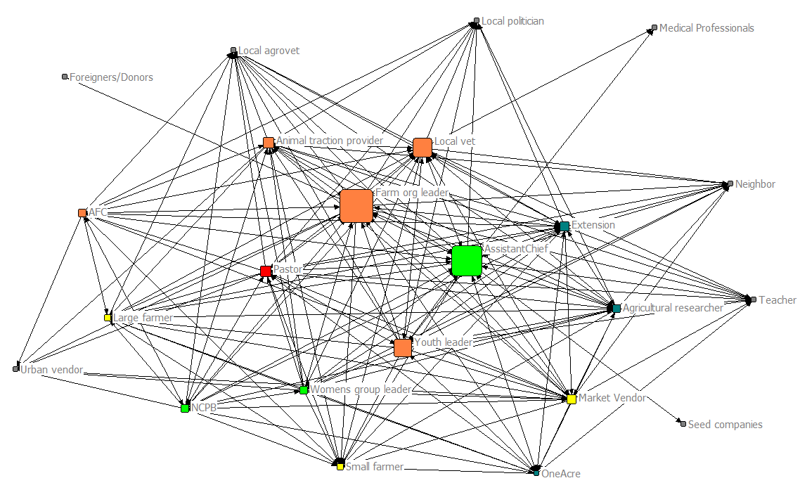
“Tillage causes land degradation”
Tillage causes land degradation
Strongly agree
Agree
Uncertain/neutral
Disagree
Strongly disagree
Not interviewed
Mapped Network of Agricultural Information flows and actor beliefs

Slide 35
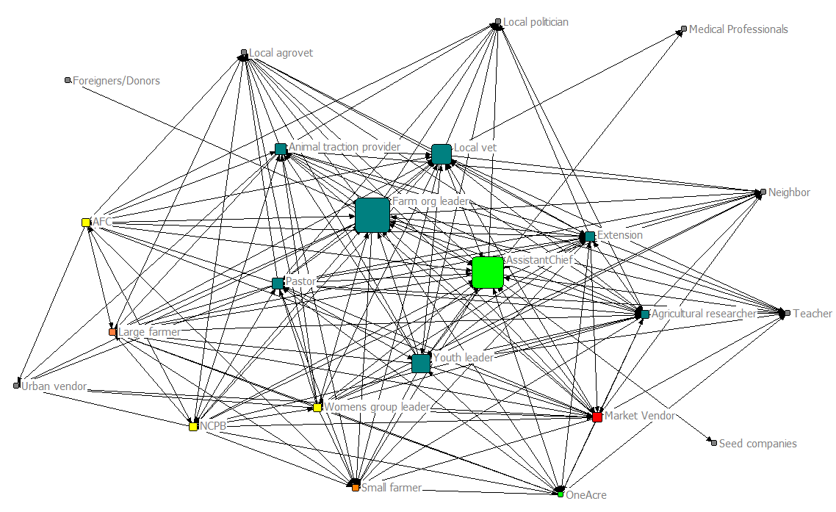
“One should maintain a permanent crop cover”
Strongly agree
Agree
Uncertain/neutral
Disagree
Strongly disagree
Not interviewed
Mapped network of information flows and beliefs

Slide 36
How can we use this information to promote CA within the agricultural production network?
Who are the important constituencies to be reached?
  Small farmers? Large farmers? Agro-vets? Etc.
What strategies are most appropriate for these groups?
  Education? Demonstrations? Etc.
Who are the key transmitters of information in the network?
  Are there others who were not mentioned?
How should we enlist the assistance of these persons to better connect farmers to information and resources?
  About agriculture? About CA?
What are the remaining challenges (agronomic, economic, practical, etc.) to be resolved for successful CA in Bungoma?
  Who needs to be brought together to resolve these issues?

